Slide 1
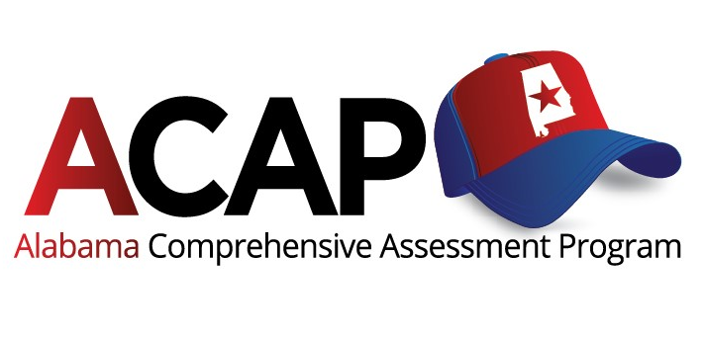
ACAP Summative Reading Subtest

Slide 2
Changes
to the
ACAP Summative Reading Subtest
The reading tests for Grades 2 and 3 are subsets of the English Language Arts (ELA)tests.
In 2023, the tests have been updated to:
Reflect the 2021 ELA Alabama Courses of Study Standards

Slide 3
ACAP Summative Reading Subtest
Reporting Categories 2022 vs. 2023
Grade 2
2022: Phonics, vocabulary, reading comprehension
2023: Phonological awareness/phonemic awareness, phonics, fluency, vocabulary, reading comprehension
Grade 3
2022: Vocabulary, reading comprehension
2023: Phonological awareness/phonemic awareness, phonics, fluency, vocabulary, reading comprehension

Slide 4
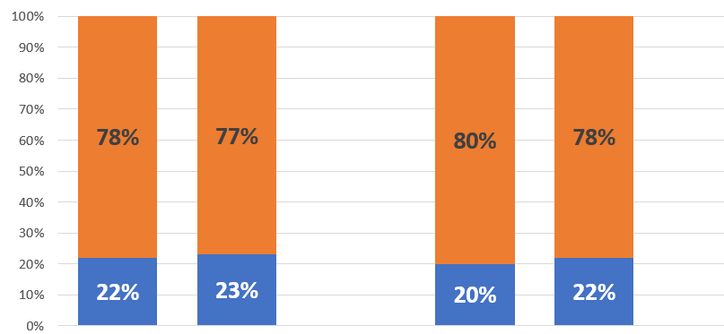
Reading Subtest Impact Data Across Years
Aligned to 2016 ELA Courses of Study Standards
2021
2022
Grade 2
Grade 3
Grade 2
Grade 3

Slide 5
2023 Reading Subtest Impact Data
Aligned to 2021 ELA Courses of Study Standards
Embargoed until June 8, 2023.
Final state reading subtest data will be provided to board members next week.
Grade 2
Grade 3

Slide 6
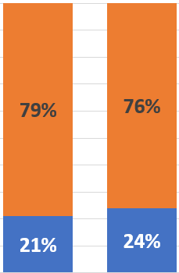
Impact Data Across Years
2021 ELA Courses of Study Standards
2023
Grade 2
Grade 3
Grade 2
Grade 3

Slide 7
Next Steps
June
Conduct ELA Standard Setting
Convene the Technical Advisory Committee (TAC) meeting to review the information/recommendations from standard setting committee
July
Present 2024 ACAP Summative Reading Subtest Cut Score recommendations to the board at the Alabama State Department of Education Board Work Session
August
Present 2024 ACAP Summative Reading Subtest Cut Score recommendations to the board at the Alabama State Department of Education Board Meeting for approval

