Slide 1
Workforce and
the Future of Work
Presented by
Chauncy Lennon, Ph.D.
VP for the Future of Learning and Work
Lumina Foundation
Feb. 15, 2019

Slide 2
Credentials

Slide 3
Good Jobs That Pay Without A BA
GCEW has defined a good job as one that pays at least $35,000 for workers 25-44 and at least $45,000 for workers 45-64.
These jobs:
pay median earnings of $56,000 for workers with less than a BA
pay median earnings of $65,000 when including workers with a BA or higher

Slide 4
30 Million “Good Jobs That Pay Without A BA”

Slide 5
Good Jobs That Pay Without a BA

Slide 6
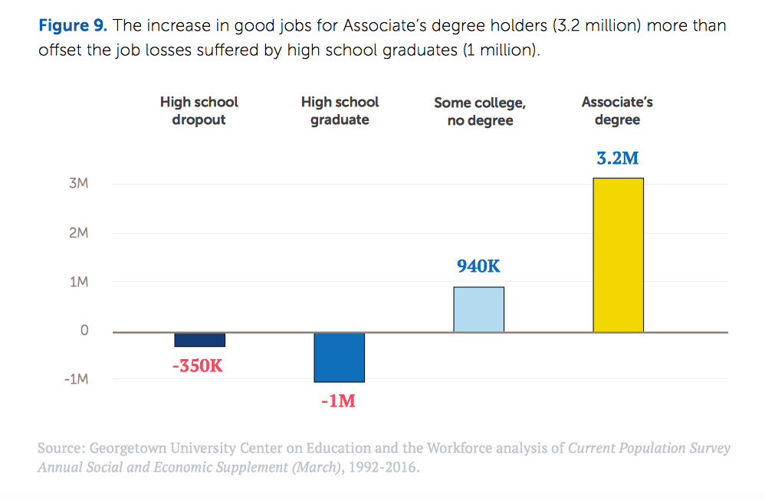
Good Jobs That Pay Without a BA

Slide 7
Alabama
Workers with associate’s degrees increased their share of good jobs by 11 percentage points from 1991 to 2015
High school graduates decreased their share of good jobs by 8 percentage points from 1991 to 2015

Slide 8
Lumina Attainment Goal: 60 percent of Americans hold a credential beyond high school

Slide 9
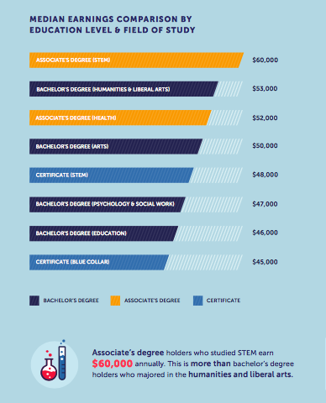

Slide 10
Alabama

Slide 11
Alabama

Slide 12
AL Non-BA Good Jobs Wages

Slide 13
Older, Worker-Learners, Parents

Slide 14
More Low-Income and Students of Color

Slide 15
Persistence and Completion Challenges

Slide 16
Attainment Gap: The 86.7 Million Opportunity
Traditional-Aged Students 24.2M
Students between the ages of 16 and 24
Returning Adult Students 18.6M
Adults who have attended college but no degree or other credential
Adults with No Postsecondary Education 43.8M
Adults with no recognized postsecondary education beyond high school

Slide 17
AL Attainment Gap

Slide 18
AL Race and Ethnicity Attainment Gaps
Hispanic Attainment: 20% (Nat. average: 21.9%)
American Indian: 33% (Nat. average: 24%)
African American Attainment: 26% (Nat. average: 30%)
White Attainment: 37.6% (Nat. average: 46.4%)
Asian and Pacific Islanders Attainment: 58.3% (Nat: 61.7%)

Slide 19
Skill Builders

